Slide 1










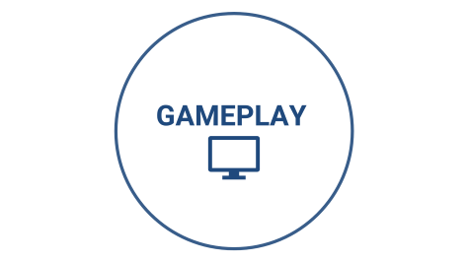

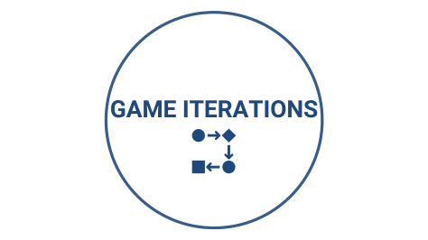



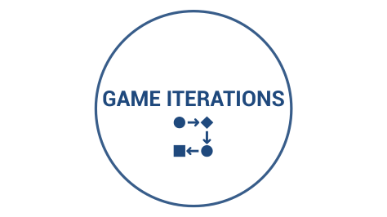




40.014 ESA Final Presentation
Team 20
BETTER SKIN CARE
FOR YOU, FOR ME, FOR ALL
Sarah
John
Min Shuen
Samuel

Slide 2

MOTIVATION

Slide 3


MOTIVATION
Who wants to have flawless and awesome skin?
Notes:
Ask question.
"You have come to the right place. WE are HERE to help you achieve that!"

Slide 4

MISSION STATMENT
Our mission is to design both an informative and interactive game such that players of the game can increase their general knowledge of skincare products through it and learn how to customize their own specific skincare routine.

Slide 5
COMBINATION TABLE
Central Decision Problem | Number of Players | Game Style | Sequencing Style
Types of Products available | 1 | Concentration Multi-Card Game | Simultaneous Play
Matching products to needs (Skin type etc) | Multiplayer | Trivia/Word game Attribute Matching (Tiles) Game | Sequential Play (Interactive step by step process)
Essential Steps in Skincare routines |  | Tile-Layering Game Connection Game | Sequential Play (Turn)
Finding similarities between differently priced products |  | Recognition Drafting Game
Knowing how to use the correct products in the correct sequence |  | Duel/Comparison Competitive Game Beat the computer or your score
Cost of Skincare products, what to buy based on budget |  | Monopoly
Notes:
This is our combination table So we mixed and match

Slide 6
REASON OF CHOICE
Pugh Matrix: Showed highest educational, retention levels and most manageable level of coding compared to games like Monopoly.
Notes:
Sequence is impt
Order of the button
Programming of the sequence
Tree structure data represent in database
A whole decision tree
Extract that and display
Repeat: How it is align to our mission goal, which is informative and interactive

Slide 7

SYSTEM DESIGN

Slide 8
SYSTEM DESIGN
By producing an operational sketch, we were able to :
Have a clear picture of the possible UI layout.
Plan out the order of the game easily due to our flow-wise operational sketch.
Write out a decision tree properly.
By architecting the system functions based on use cases and affinity analysis, we were able to:
Pre-emptively create the helper functions that corresponded to the different decisions made by the player.
Separate the database query functions.
Use cases of the player changing his/her decisions helped us derive the logical functions that would reflect these changes on the game screen.

Slide 9

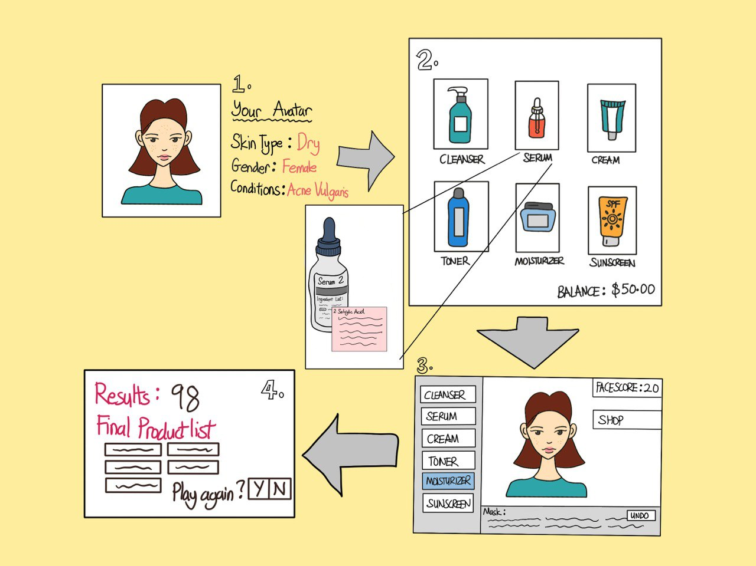
OPERATIONAL SKETCH
Shop that allows player to buy any product they want, given a fixed budget
Customisable avatar: The player can make his/her own avatar with similar skin conditions
Face score of avatar which is impacted by 2 factors:
Suitability of products
Order in which products are applied
Product description to allow player to learn more about the types of products and find out which products will be more suitable for the player.
Back to Shop Button for other products
Undo button for player to try out different sequences of applying the product
List of products previously bought by player for avatar
Notes:
Sequence is impt
Order of the button
Programming of the sequence
Tree structure data represent in database
A whole decision tree
Extract that and display

Slide 10

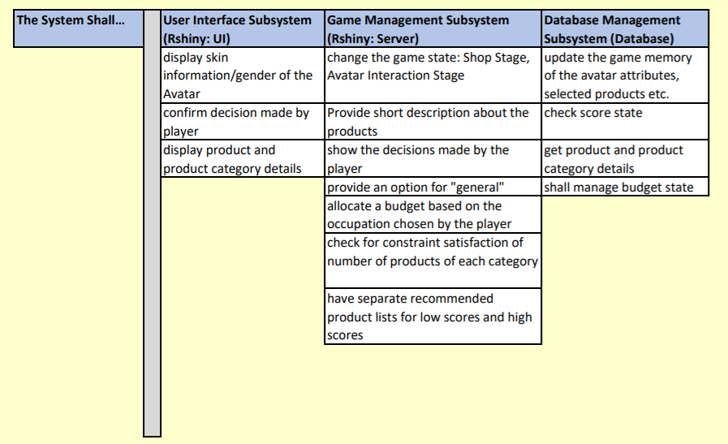
LOGICAL ARCHITECTURE

Slide 11

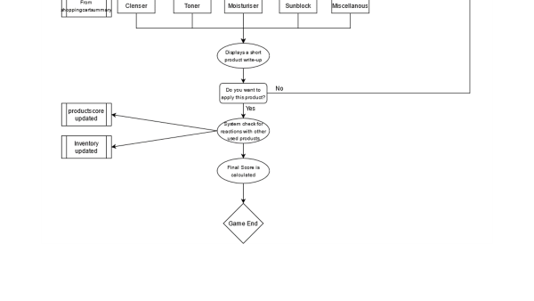
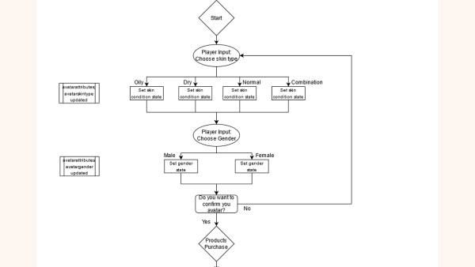
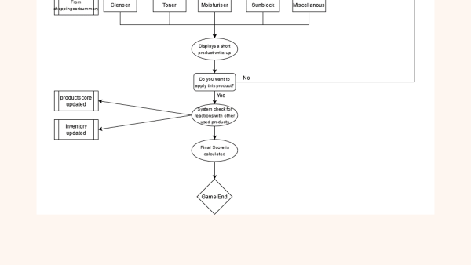
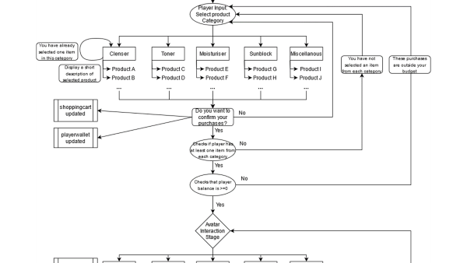
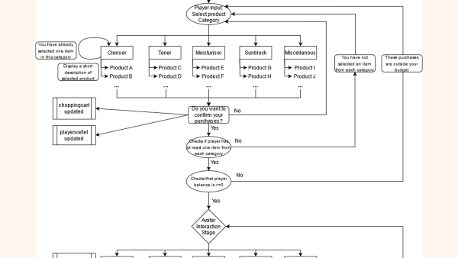
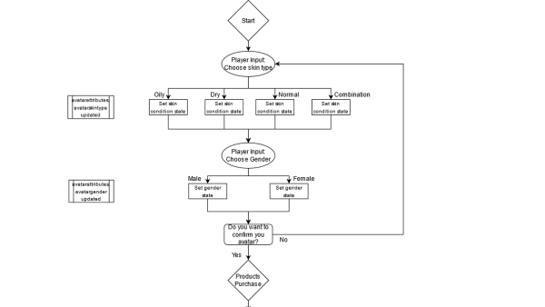
DECISION TREE

Slide 12
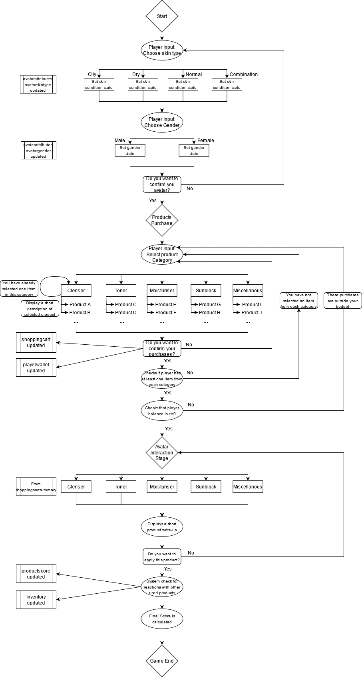

Slide 15

DIFFERENCES
In terms of the UI design, the project matched the project plan quite closely.
For the most part, our project plan provided a methodical framework that we followed as we coded the game. (More in later slides)
The actual game differed from the project plan in terms of how certain elements of the UI function.
The motivations for changes in our coding functions arose from our own playthrough of the game.

Slide 16

GAME ITERATIONS

Slide 17
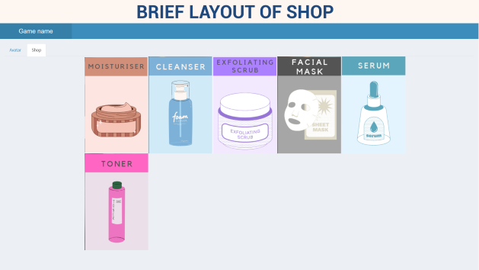
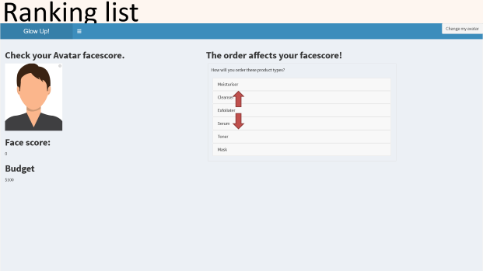
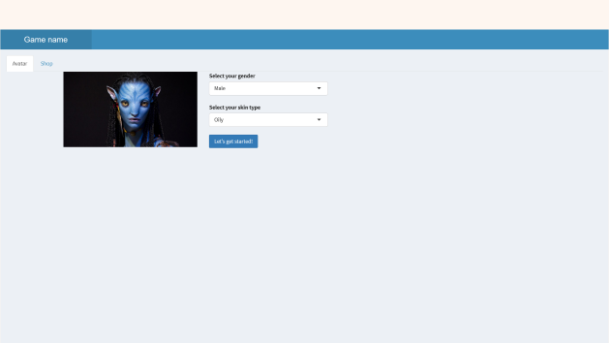
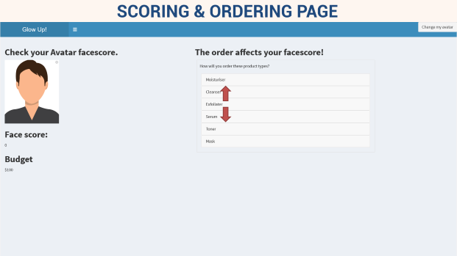
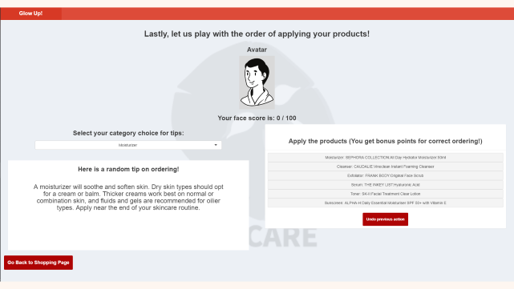
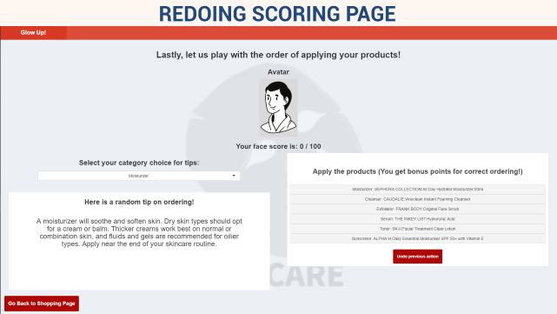
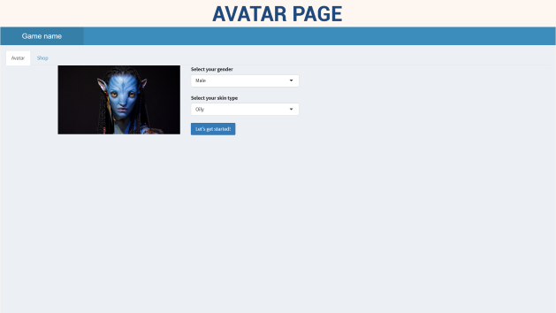
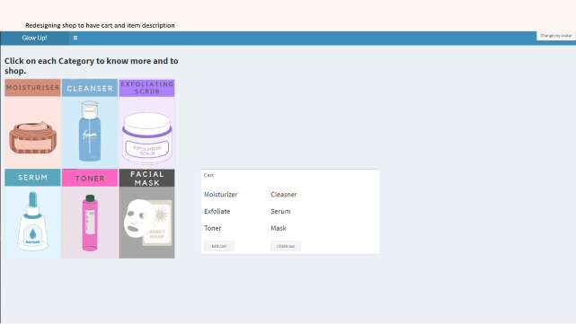
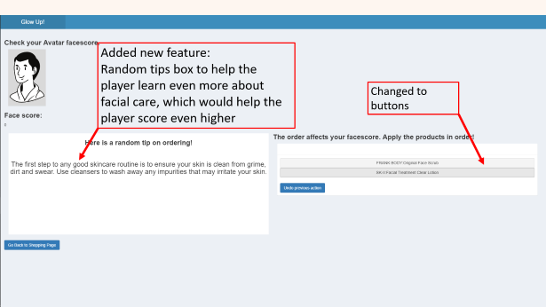
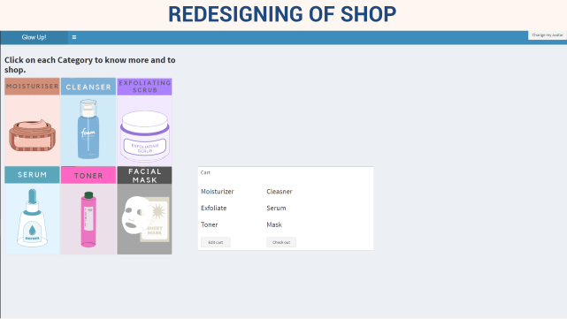
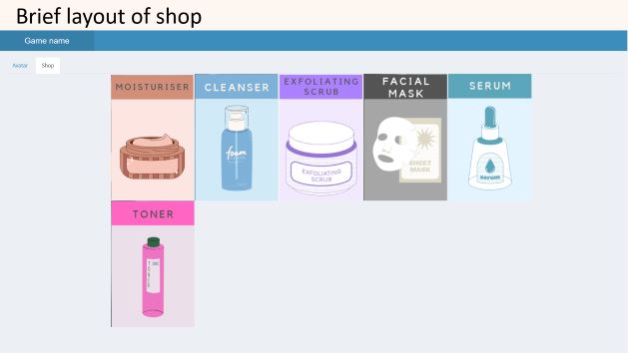
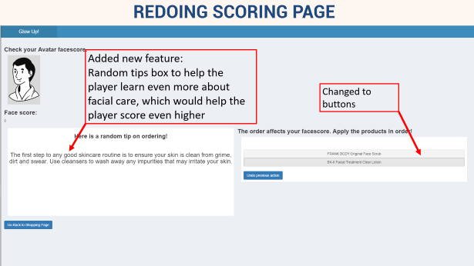
GAME ITERATIONS

Slide 18
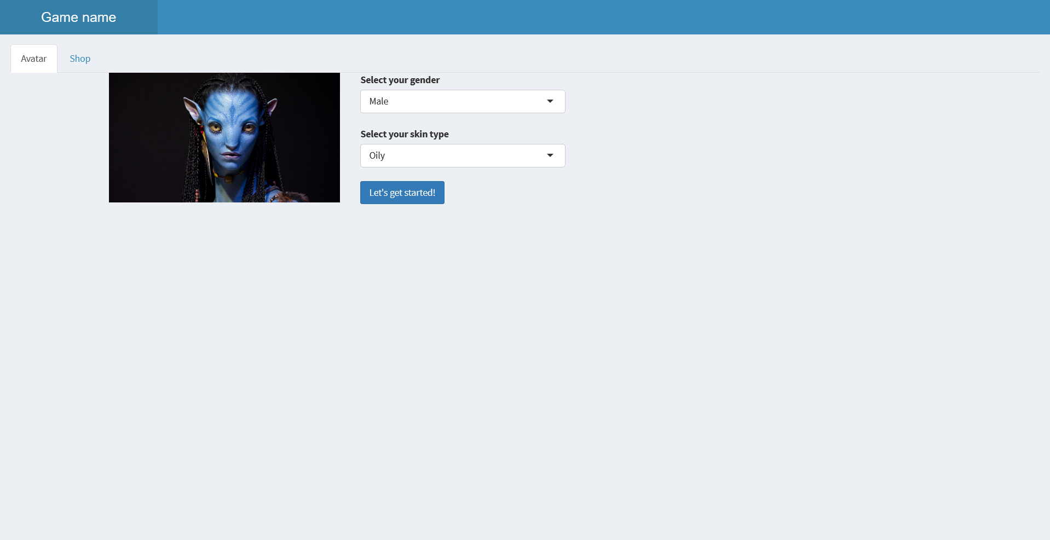
AVATAR PAGE

Slide 19
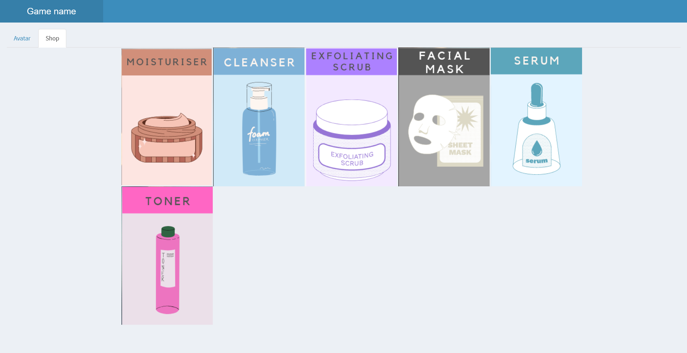
BRIEF LAYOUT OF SHOP

Slide 20
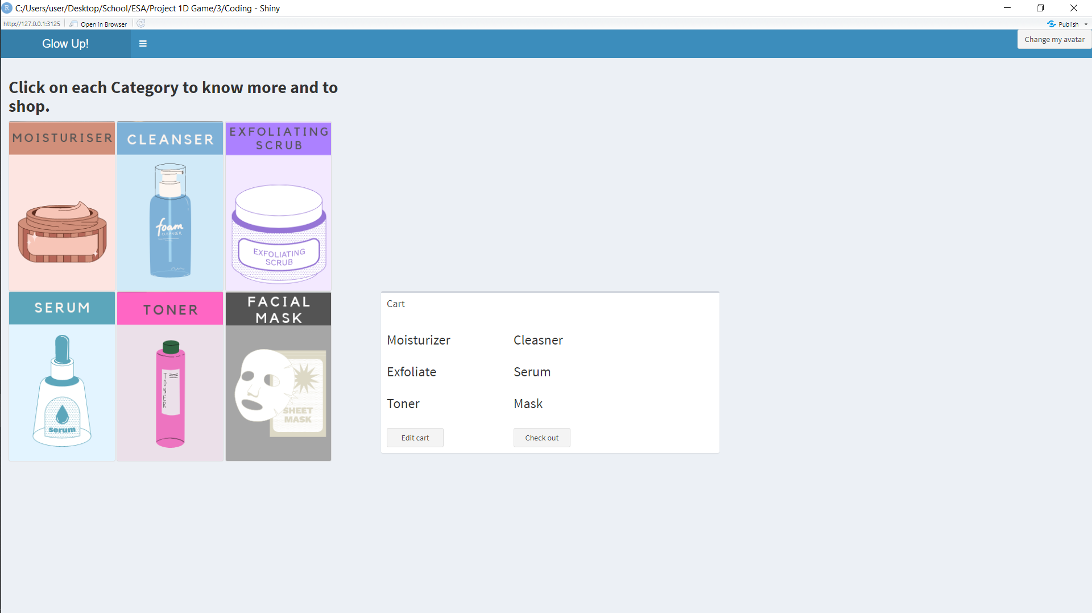
REDESIGNING OF SHOP

Slide 21
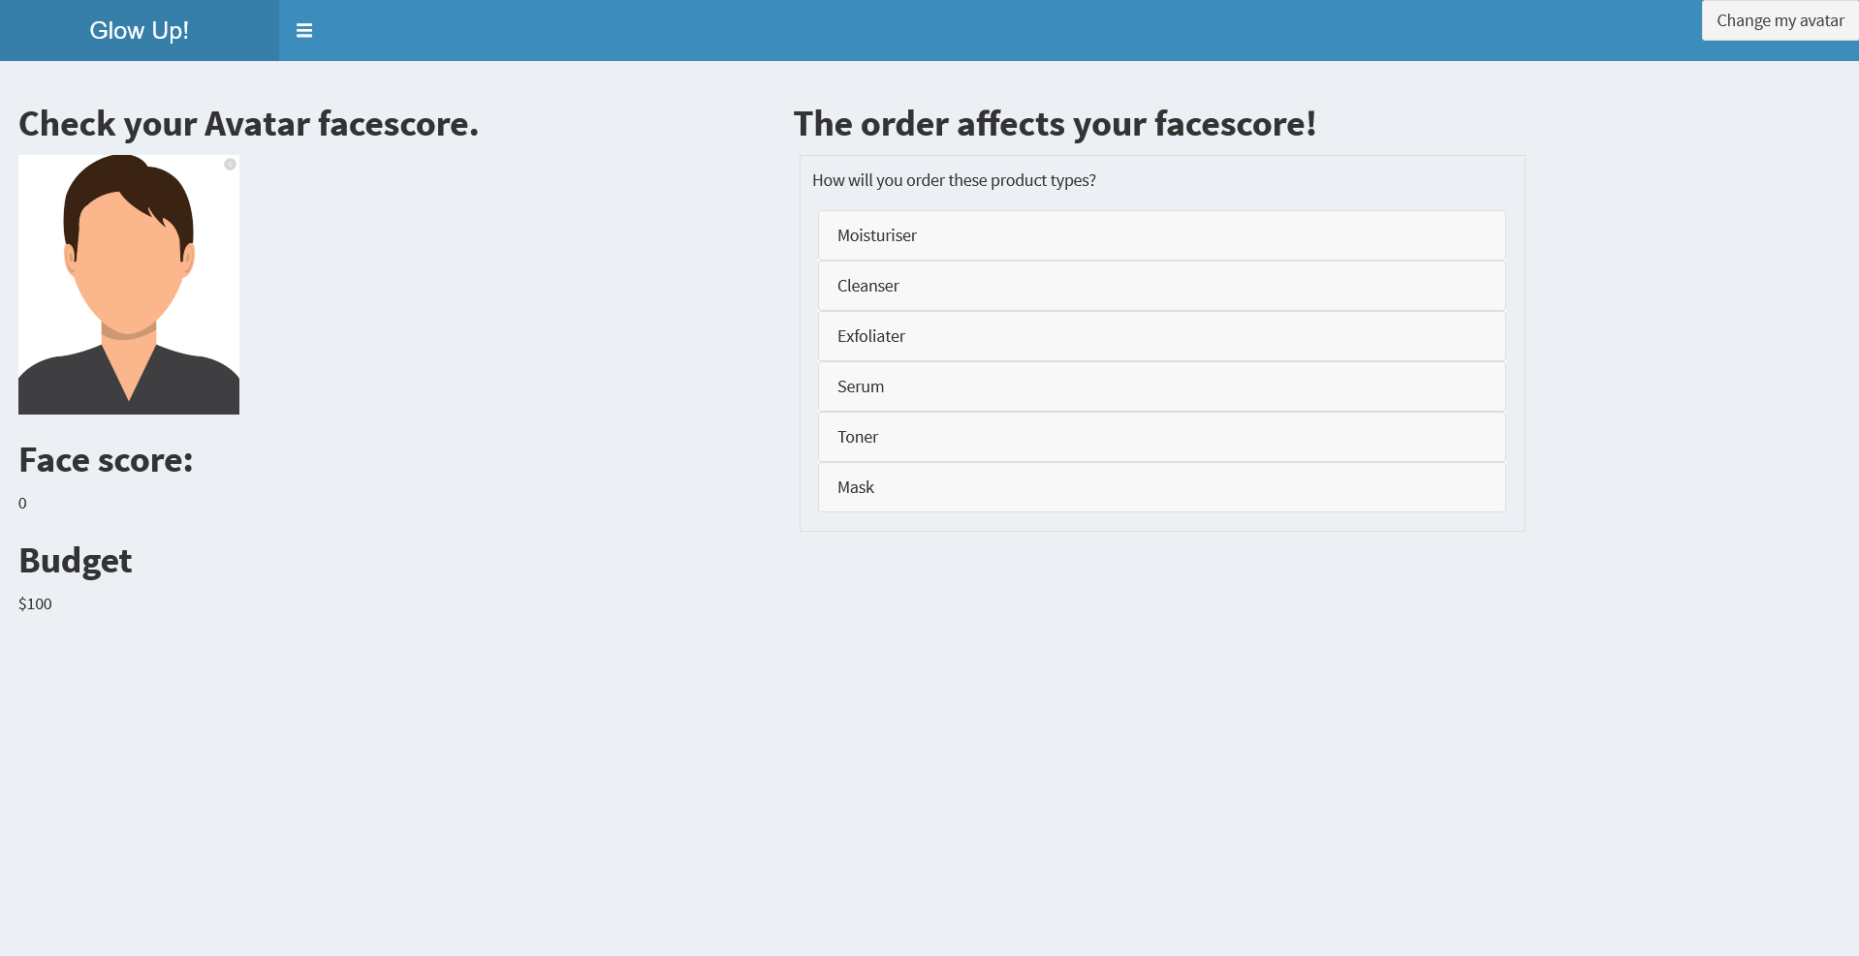
SCORING & ORDERING PAGE

Slide 22
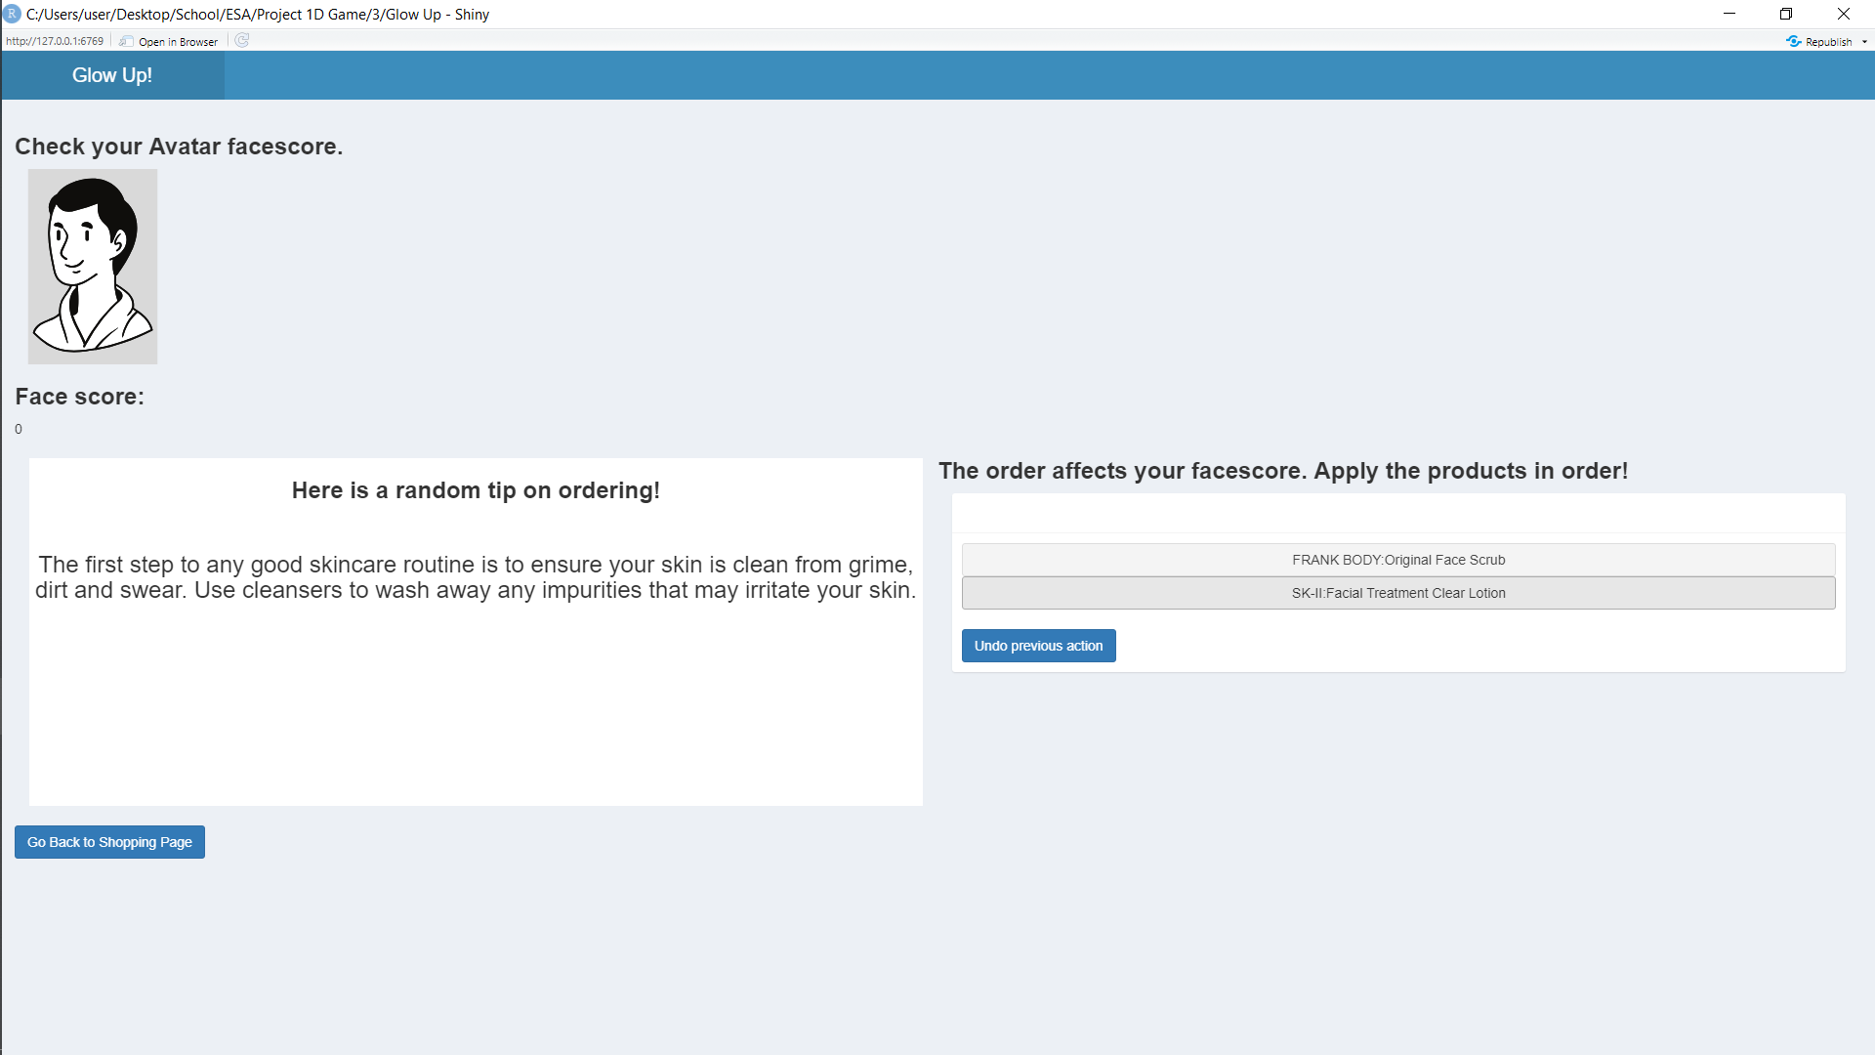
REDOING SCORING PAGE
Added new feature:
Random tips box to help the player learn even more about facial care, which would help the player score even higher
Changed to buttons

Slide 23
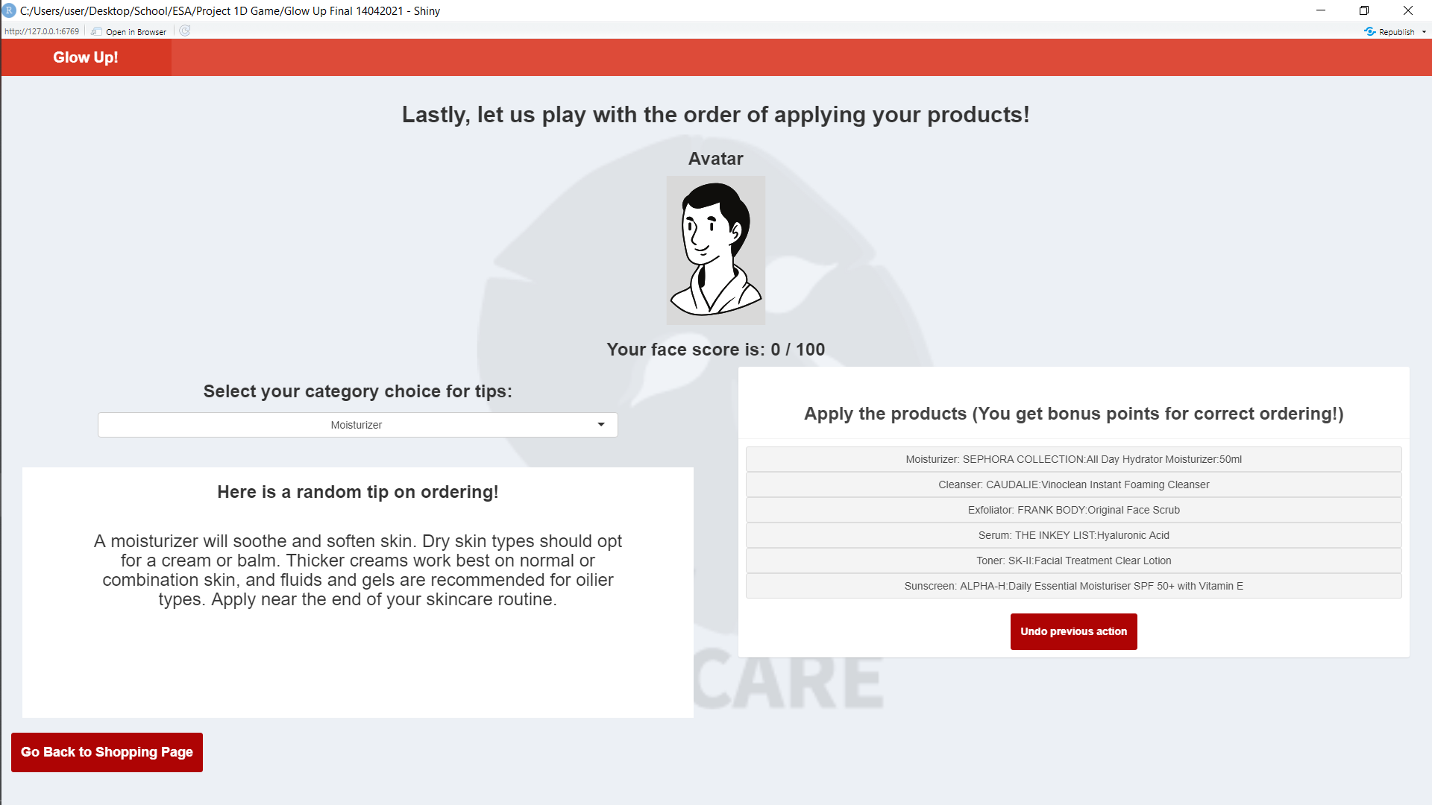
REDOING SCORING PAGE

Slide 24
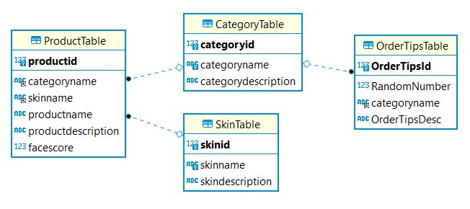
DATABASE FINAL DESIGN

Slide 25

FUNCTIONAL CHANGES

Slide 26
FUNCTIONAL CHANGES
Initial scoring system:
Player’s score = product score + order score
Problem:
Incorrect / inaccurate scores when player “buys” less than 6 products from shop
Final scoring system:
Use of a multiplier system,
Player’s score = product score + (bonus score * some multiplier)
Multiplier based on order in which products are applied

Slide 27
FUNCTIONAL CHANGES
Initial procurement:
Scraped Internet for products to include in game
Problem:
Too many products available on the market.
Products covered in game might not be sufficient in educating player to choose products in real life
Solution:
Added a random tips feature that would improve the player’s knowledge
Conducted research on what makes certain products more appropriate for different skin types and created our own fictional products

Slide 28

GAMEPLAY

Slide 29
GAMEPLAY
https://samuelsim.shinyapps.io/GlowUp/

Slide 30

TAKEAWAYS

Slide 31
TAKEAWAYS
Debugging Techniques
The print() function helped us identify the root cause of certain errors – Non-query related errors that arose from the database were impossible to identify from looking at the R code otherwise.
System Architecture
Very important and essential, it made our workflow much smoother.
Not lost during the process as we had everything written out from our mission to the decision tree.

Slide 32

40.014 ESA Final Presentation
Team 20
BETTER SKIN CARE
FOR YOU, FOR ME, FOR ALL
Sarah
John
Min Shuen
Samuel

Slide 33
BETTER SKIN CARE
FOR YOU, FOR ME, FOR ALL
THANK YOU BEAUTIFUL PEOPLE
We are ready to answer your questions.

